Slide 1


Quantum GPT Model
# qgpt-issue-31 #
Hybrid Algorithm to Explore Properties of GPT in Quantum Transformer Models.
GitHub Link
Mentors:
Kavitha Yogaraj
Dr. Brian Quanz
Mentees:
Harshdeep Singh
I-Chi Chen
Anu Vadali

Slide 2
Outline
Problem Statement
Literature Survey
Classical Vision Transformers
Quantum Vision Transformers
Classical text classification by Transformers
QSAN text classification
Challenges
Plan

Slide 3
Problem Statement:
Classical transformer models involve self-attention mechanisms to capture contextual relationships between the input tokens and effectively model long-range dependencies.
The issue with developing Quantum Transformers is that transformers in general are large and require a lot of data to work effectively.
The core of the GPT models is the transformer architecture and hence here for the short time we have we would like to focus Quantum Transformer application on Images and Text.
The proposal is to survey available literature on quantum transformers for Text & Image classification and provide a survey paper as a possible deliverable.
Also, to extend the current approaches and to do experimental analysis to validate the proposed implementation and do a comparative study.
Notes:
(Hypothesis is once we have a good Quantum transformer we can apply to anything)

Slide 4
Literature Survey
Quantum Transformers for Image Classification
An improved novel quantum image representation and its experimental test on IBM quantum experience
Quantum Vision Transformers
Quantum Transformers for Text Classification
Quantum Self Attention Models for Text Classification
Quantum Self-Attention Neural Networks for Text Classification
Quantum Transformers
Quantum circuits with Transformer
– Not much work done, only work done is on QSAN above.
LSTM for Sequential Data
Quantum LSTMs
Quantum Recurrent Neural Networks for Sequential Learning

Slide 5
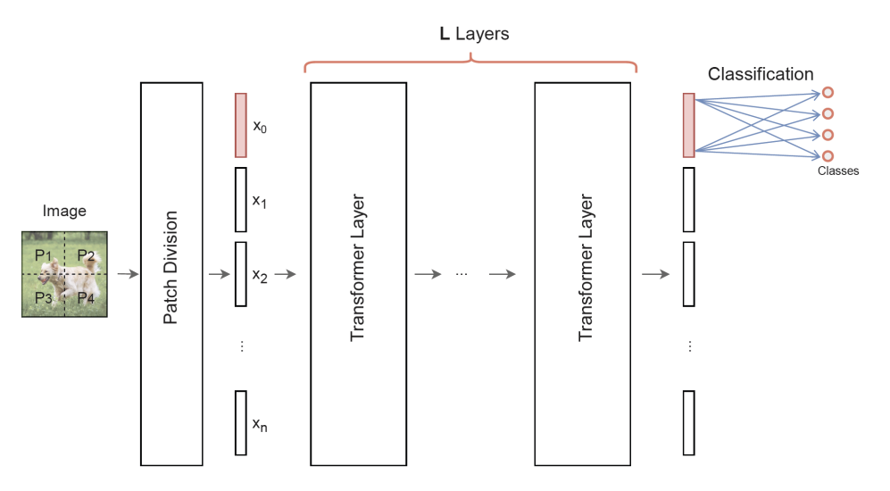
Classical Vision Transformers
In Vision Transformers, each image is divided into small patches.
Each of the patch is then embedded into a vector and alongside a class embedding vector, is fed into a transformer layer.
The final classification is done from the vector corresponding to the class embedding vector.
Image Credits: Quantum Vision Transformers

Slide 6
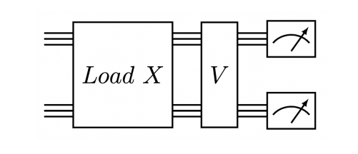
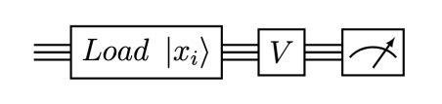
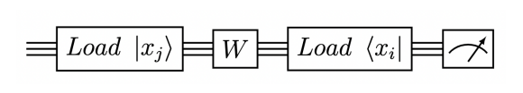
Quantum Vision Transformers
Quantum Vision Transformers involve encoding the image data using quantum data loaders (e.g, Unary quantum data loaders) and performing the matrix multiplication, and calculating attention coefficients involved in transformer layers with quantum circuits.
Matrix Multiplication Vx with a quantum circuit
Evaluating attention coefficients x^{T}Wx with a quantum circuit
Another transformer architecture, called the compound transformer has been proposed which is much simpler in structure and is supposed to perform equally well.
These two components along with a quantum data loader constitute a Quantum Vision Transformer
Image Credits: Quantum Vision Transformers

Slide 7
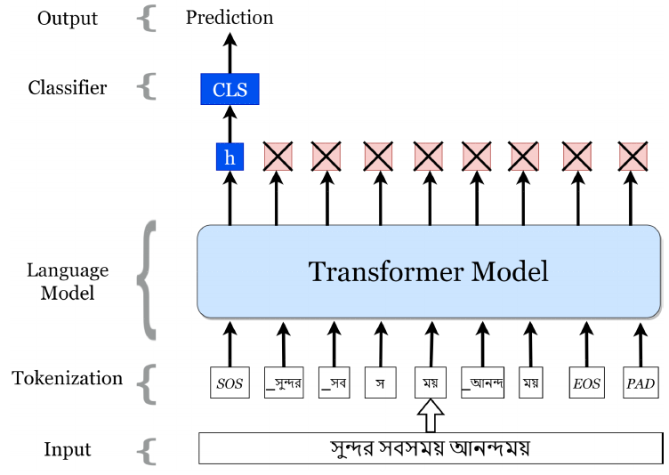
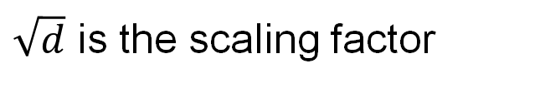
Classical text classification by Transformers
Scaled dot product attention
$$Attention=softmax\left(\frac{QK}{\sqrt{d}}\right)V$$
$\sqrt{d}$ is the scaling factor
arXiv: 2011.04446

Slide 8
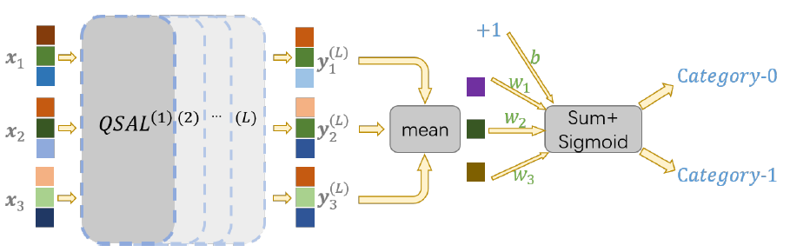






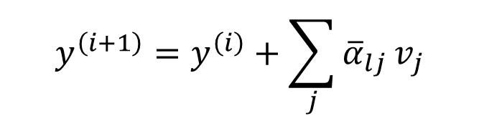









QSAN text classification
PQC
Gaussian Projected Quantum Self-Attention
Q
K
V
Q
K
V
Q
K
V
with
arXiv: 2205.05625

Slide 9
Cost a lot of time to train for 1 epoch -100hrs
Too many circuits to implement
No clear quantum advantage
(50000 vocab size)
Challenges
Quantum transformer for Text
Quantum transformer for Images
Data Encoding: Patches of images are encoded into the quantum circuits with unary embedding technique, where the number of data points that can be encoded into the circuit scale linearly with the number of qubits.
Not Leveraging the Quantum Enough: The construction of quantum vision transformers does a literal translation from classical transformers and hence there is no clear advantage to the results.
Quantum Compound Transformers: The construction and working of the compound transformer is yet to be understood.

Slide 10

Plan
Agile Methodology– Continuous Research – Continuous validation
Scoping Phase
Tested code from repositories to obtain an understanding of classical and quantum transformer models.
Surveyed literature on transformer models Text
Coding/Research Phase
Start Writing the Survey Paper
To propose and implement an extension.
Experimental Phase
To do experimental analysis.
To do a comparative study
Found and assembled required code such as converting parameterized circuits to PyTorch Tensor.
To validate the proposed implementation
Surveyed literature on transformer models Image

Slide 11
Thank you!

